Slide 1
IRMA

Slide 2
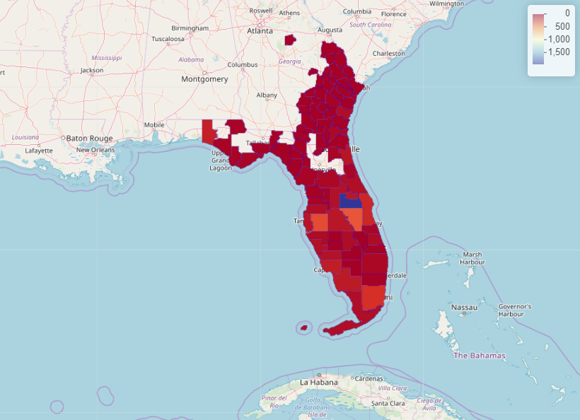
Residents of zones affected by Hurricane Irma (prior to the hurricane)

Slide 3
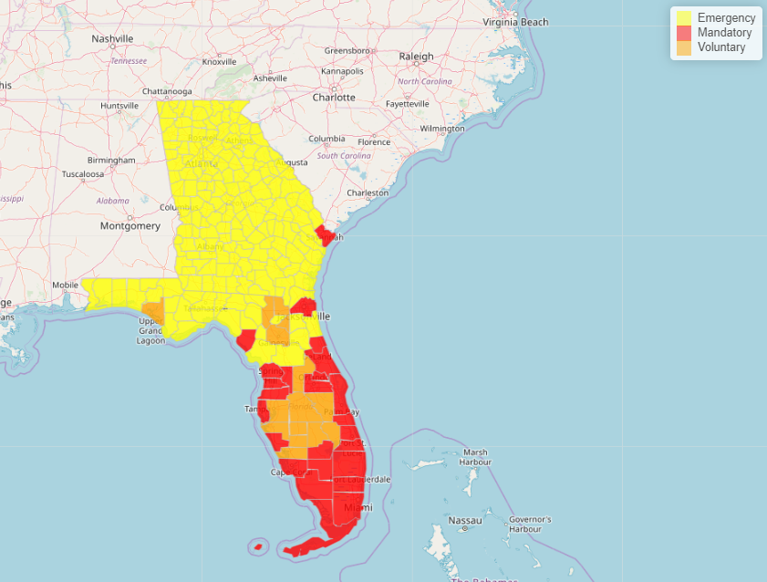
Evacuation Measures prior to Hurricane Irma

Slide 4
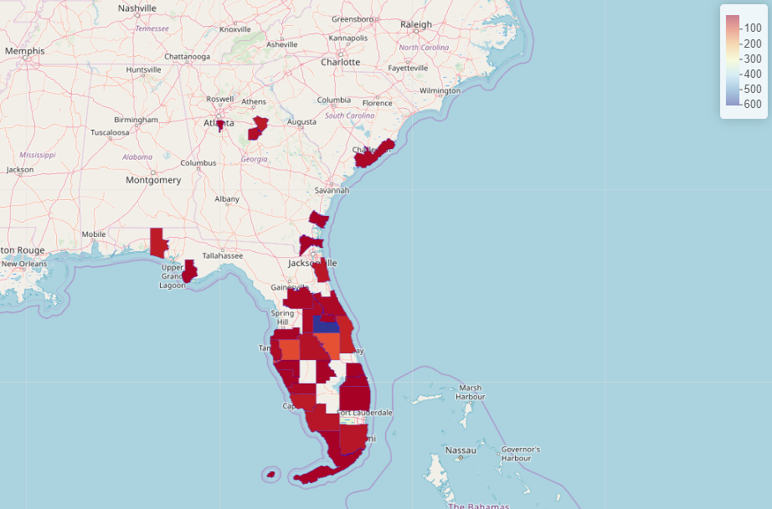
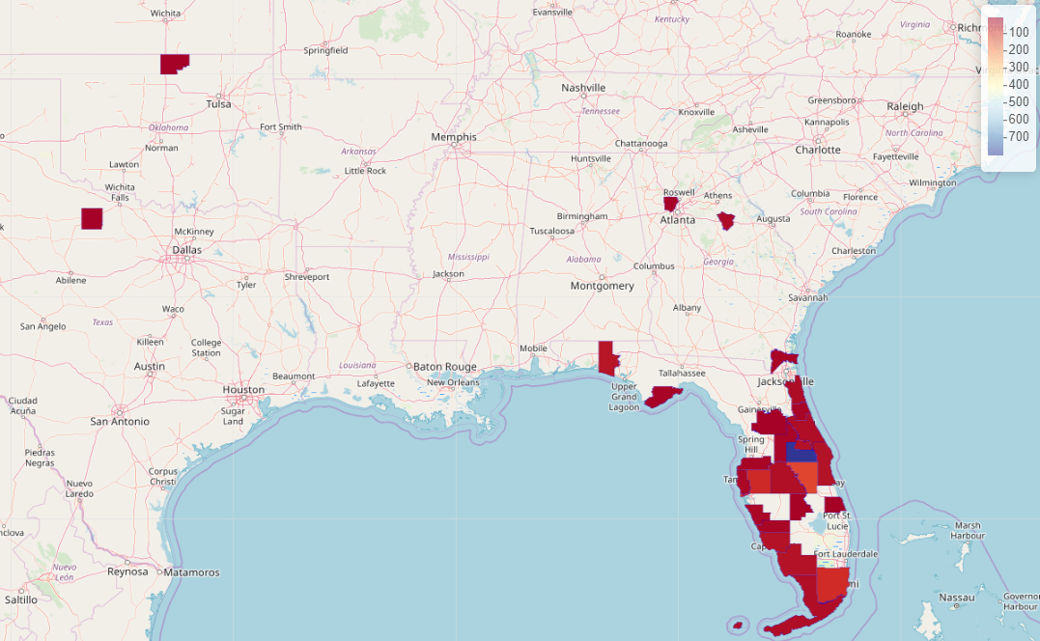
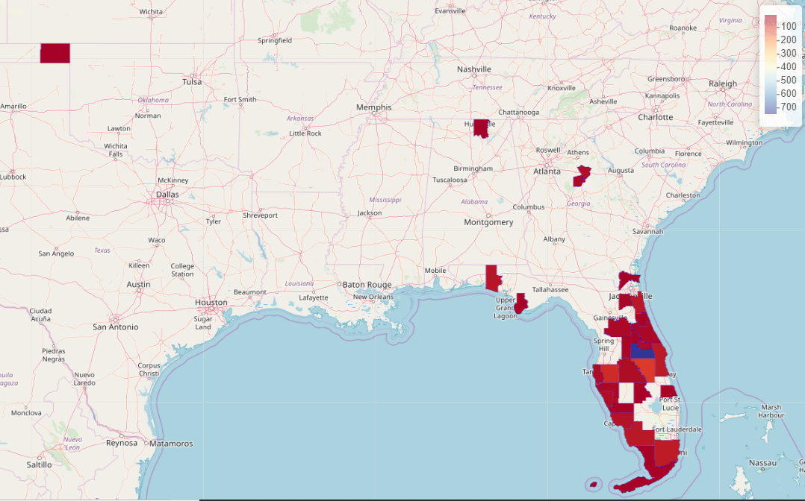
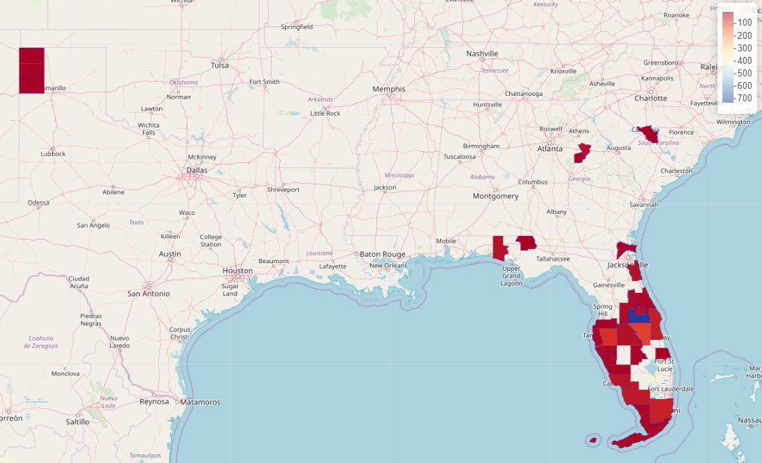
Migration from 2017-08-01 to 2017-08-04
Migration from 2017-08-05 to 2017-08-08
Migration from 2017-08-09 to 2017-08-12
Migration from 2017-08-13 to 2017-08-16

Slide 5
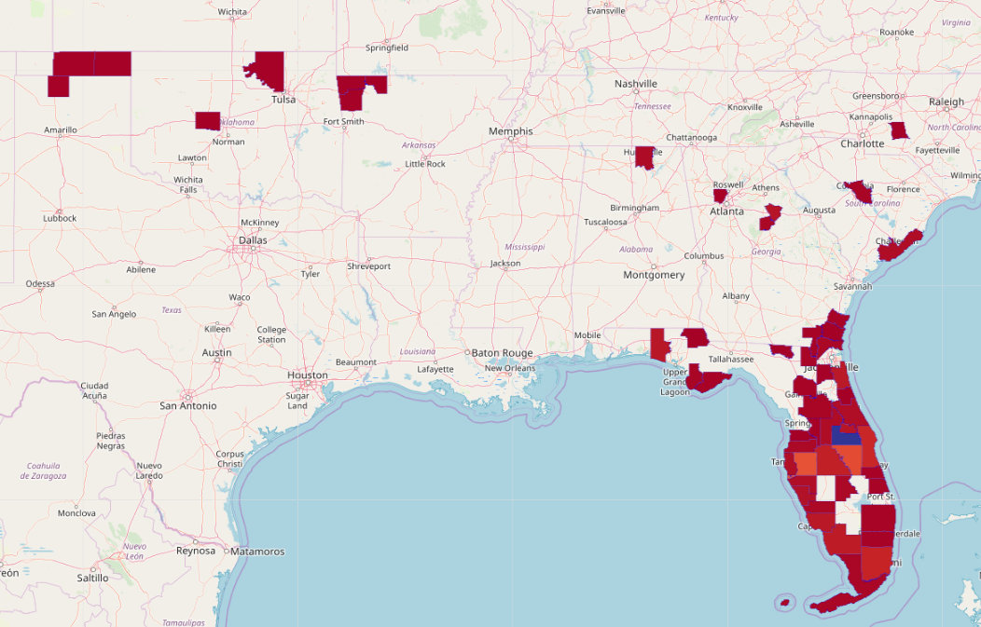
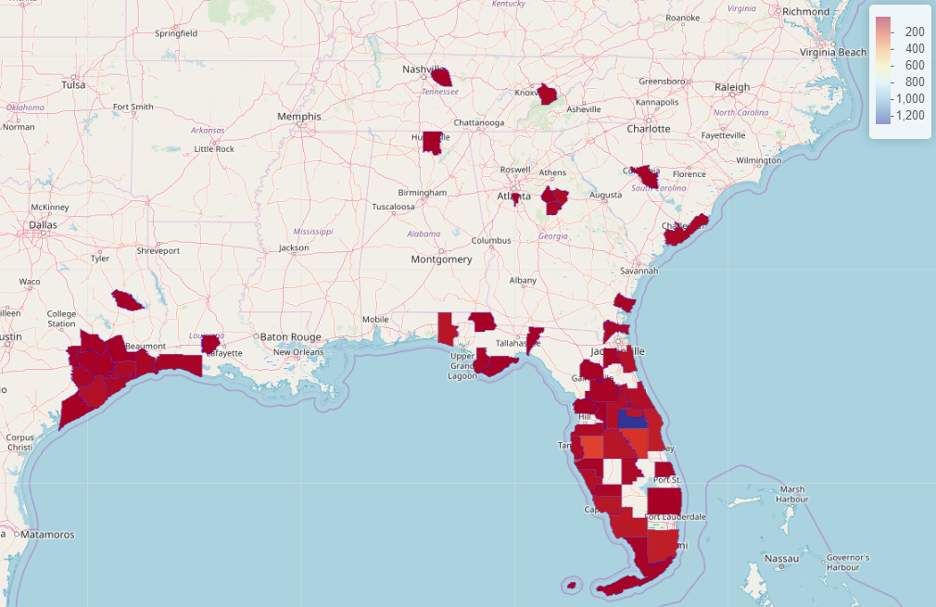
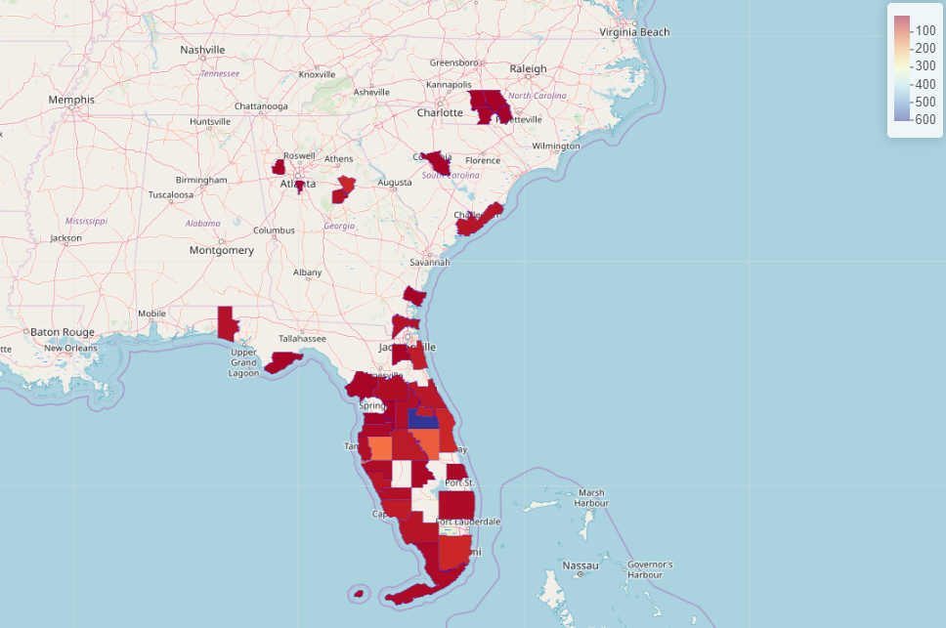
Rehab from 2017-08-21 to 2017-08-27
Rehab from 2017-08-28 to 2017-09-03
Rehab from 2017-09-04 to 2017-09-10

